Slide 1
Finding the most similar hotel

Slide 2
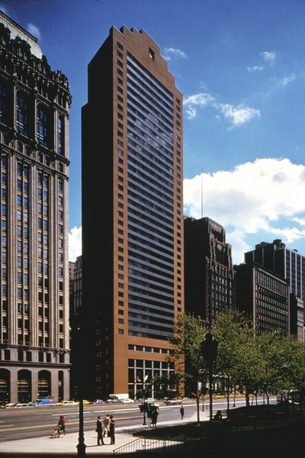
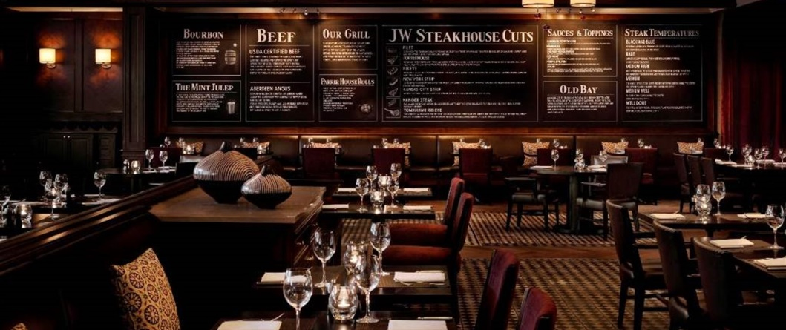

Background
Marriott Hotels recently opened a steakhouse in New York Marriot Downtown. Based on its success, the owners would be interested to open another steakhouse in one of its Chicago hotels.
Can we help to find a suitable location, based on similarity between hotels ?
Disclaimer: real names of the hotels were used for demonstration purposes only

Slide 3
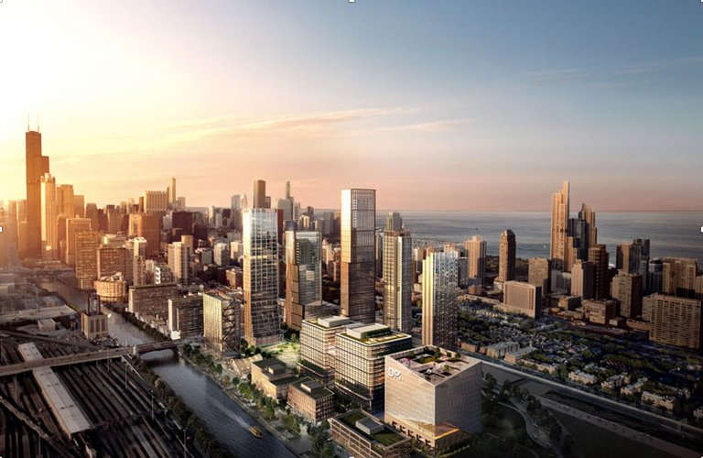
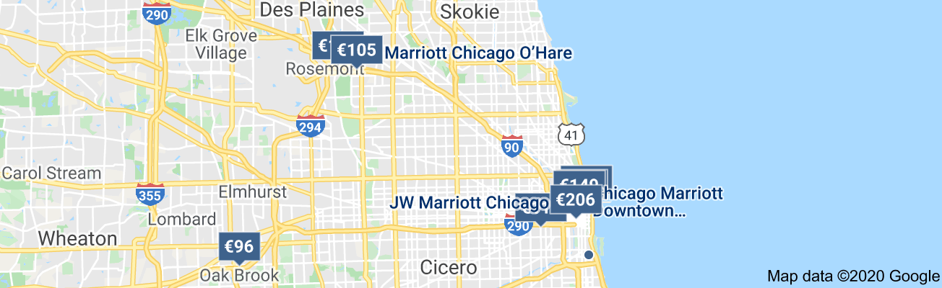
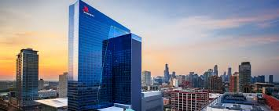
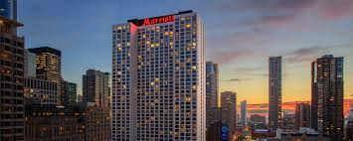
Background
The company provided the list of candidate hotels located in Chicago for further consideration.
Which of the candidates is would have the most similar customer base to New York Marriot Downtown ?
Disclaimer: real names of the hotels were used for demonstration purposes only

Slide 4
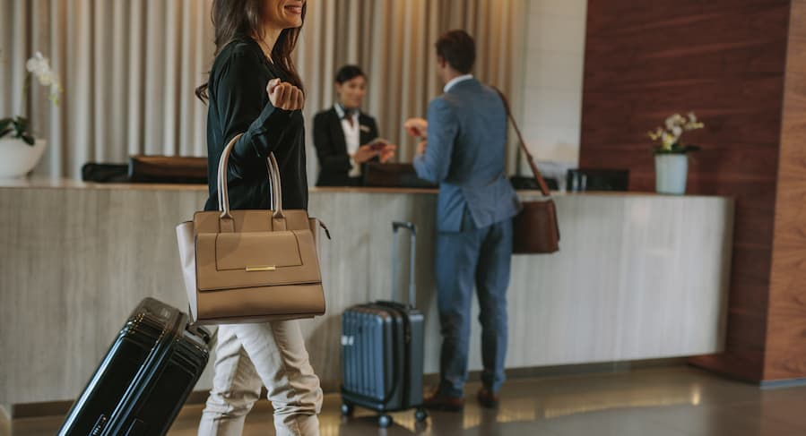
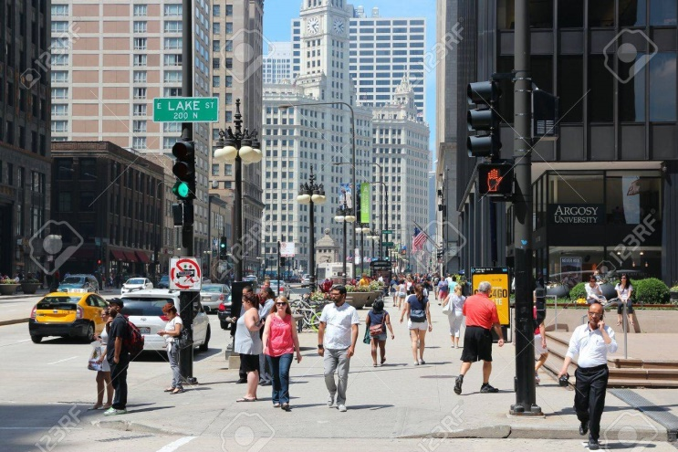
Background
The potential clientele can be divided into two main parts:
2) City residents and tourists staying in other places
Hotel guests
We should somehow address both of these factors !
How can we do that using geolaction data provided by FourSquare API and some other publically available data ?

Slide 5
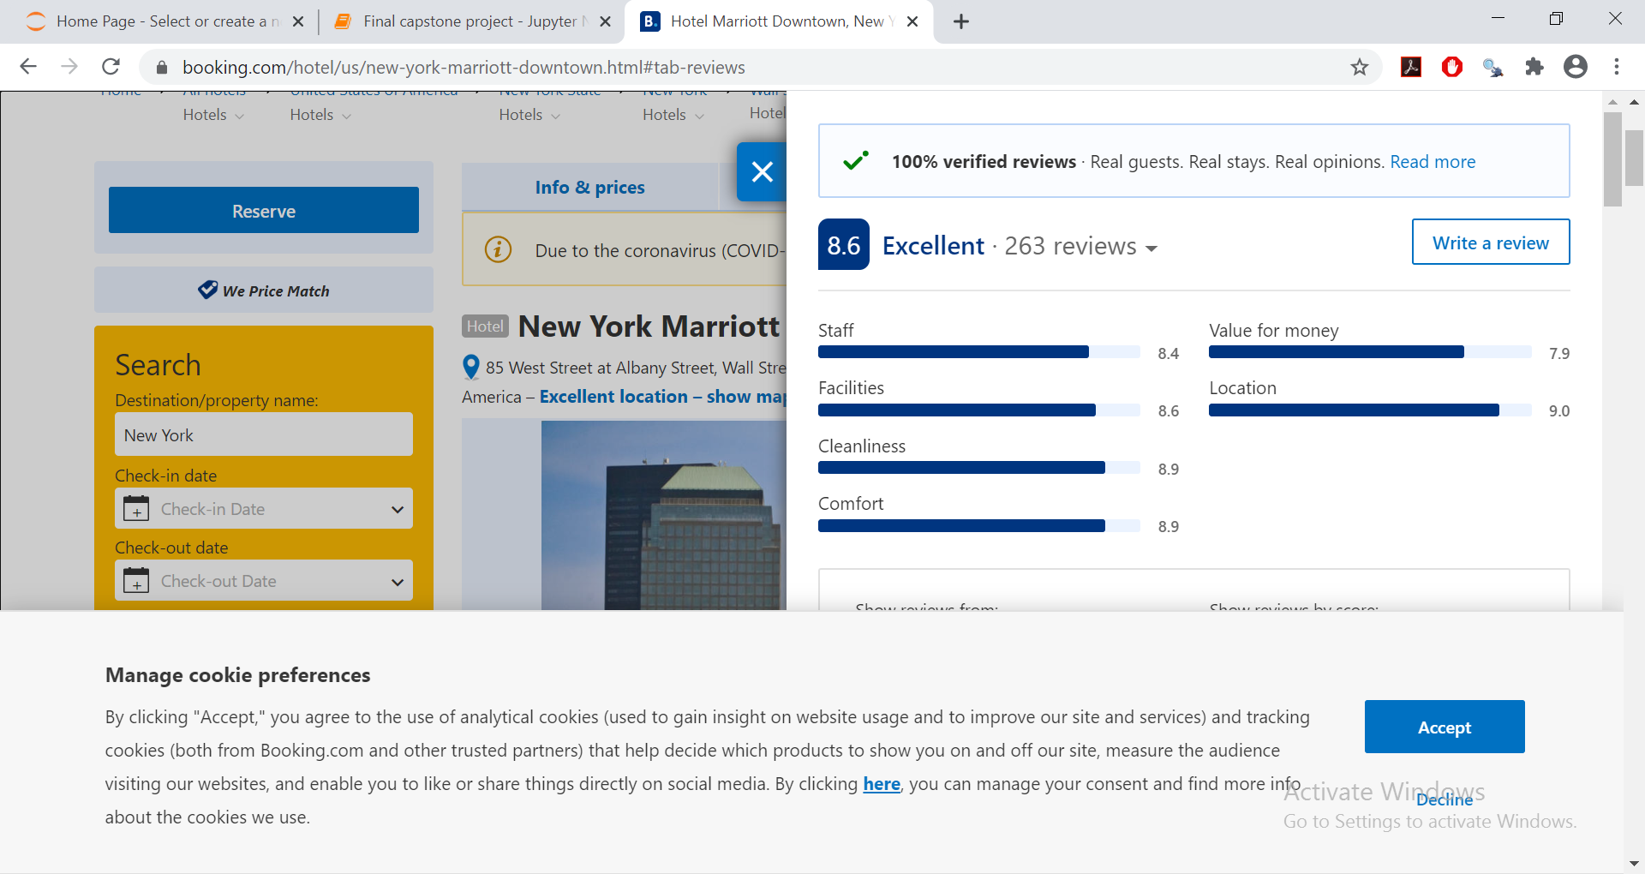
Data for evaluation of hotel guests similarity
Guests of the hotel might have similar attitudes when evaluating both hotel and eating establishments.
We used customer review data presented in www.bookings.com.
The collected data will serve as reviews profile of the hotel.
Name | Staff | Facilities | Cleanliness | Comfort | Value for money | Location
New York Marriott Downtown | 8.4 | 8.6 | 8.9 | 8.9 | 7.9 | 9

Slide 6
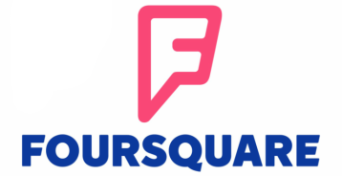
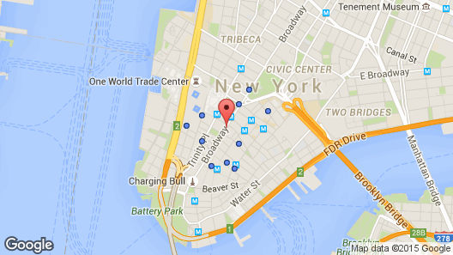

Data for evaluation of neighborhoods similarity
Types of venues located nearby might be connected to the foot traffic of possible clientele.
We used FourSquare API to extract data about the types of venues located around the hotels.
The collected data will serve as neighborhood profile of the hotel.
Name | Sites | Shops | Foods | Restaurants | Steakhouses | Other
New York Marriott Downtown | 0.280 | 0.290 | 0.210 | 0.070 | 0.010 | 0.140

Slide 7
Evaluation of features similarity
How similar are the reviews and/or neighborhood profiles of two different hotels ?
Name | Staff | Facilities | Cleanliness | Comfort | Value for money | Location
New York Marriott Downtown | 8.4 | 8.6 | 8.9 | 8.9 | 7.9 | 9
Name | Staff | Facilities | Cleanliness | Comfort | Value for money | Location
Chicago Marriott Midway | 8.3 | 8.3 | 9 | 8.8 | 7.6 | 8.6
To measure dissimilarity between profile vectors, we will estimate Euclidian distances:
$$d=\sqrt{{\left(8.3−8.4\right)}^{2}+{\left(8.3−8.6\right)}^{2}+…+{\left(9−8.6\right)}^{2}}=20.28$$
Two types of analysis will be performed based on these measures:
Rank analysis (separate and combined)
Cluster analysis (k-nearest neighbors method)

Slide 8
Results: similarity of reviews profiles
Name | Distance | Rank
Chicago Marriott Southwest at Burr Ridge | 20.5873 | 4
Chicago Marriott at Medical District/UIC | 21.4152 | 7
JW Marriott Chicago | 20.5117 | 3
Chicago Marriott Downtown Magnificent Mile | 21.0884 | 6
Marriott Marquis Chicago | 21.4551 | 8
Chicago Marriott Midway | 20.2765 | 2
Marriott Chicago O’Hare | 19.5790 | 1
Chicago Marriott Suites O’Hare | 21.5638 | 9
Chicago Marriott Oak Brook | 20.9445 | 5
Thus, based on customer reviews, the following three hotels are the most similar to the New York Marriott Downtown:
1) Marriott Chicago O’Hare
2) Chicago Marriott Midway
3) JW Marriott Chicago.

Slide 9
Results: similarity of neighborhood profiles
Name | Distance | Rank
Chicago Marriott Southwest at Burr Ridge | 0.4264 | 8
Chicago Marriott at Medical District/UIC | 0.3633 | 6
JW Marriott Chicago | 0.2994 | 2
Chicago Marriott Downtown Magnificent Mile | 0.3499 | 3
Marriott Marquis Chicago | 0.3600 | 4.5
Chicago Marriott Midway | 0.4315 | 9
Marriott Chicago O’Hare | 0.4040 | 7
Chicago Marriott Suites O’Hare | 0.2113 | 1
Chicago Marriott Oak Brook | 0.3600 | 4.5
Thus, based on reviews profiles, the following three hotels are the most similar to the New York Marriott Downtown:
1) Chicago Marriott Suites O’Hare
2) JW Marriott Chicago.
3) Chicago Marriott Downtown Magnificent Mile

Slide 10
Results: combined similarity
Name | Reviews | Neighbourhood | Sum of ranks
Chicago Marriott Southwest at Burr Ridge | 4 | 8 | 12
Chicago Marriott at Medical District/UIC | 7 | 6 | 13
JW Marriott Chicago | 3 | 2 | 5
Chicago Marriott Downtown Magnificent Mile | 6 | 3 | 9
Marriott Marquis Chicago | 8 | 4.5 | 12.5
Chicago Marriott Midway | 2 | 9 | 11
Marriott Chicago O’Hare | 1 | 7 | 8
Chicago Marriott Suites O’Hare | 9 | 1 | 10
Chicago Marriott Oak Brook | 5 | 4.5 | 9.5
Thus, JW Marriot Chicago is most similar to New York Marriott Downtown, based on the combined similarity measure (5):
1) 3rd most similar based on reviews;
2) 2nd most similar based on neighborhood similarity.

Slide 11
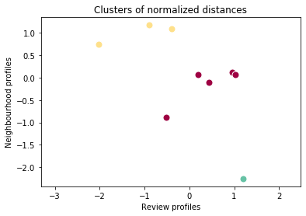
Results: cluster analysis
Cluster | Distance (reviews) | Distance (neighbourhood)
0 | 21.08 | 0.3465
1 | 20.15 | 0.4206
2 | 21.56 | 0.2113
Cluster analysis revealed three types of Chicago hotels based on similarity to New York Marriott Downtown:
1) average reviews similarity, average neighborhood similarity
2) higher reviews similarity, lower neighborhood similarity
3) lower reviews similarity, higher neighborhood similarity.

Slide 12
Results: cluster analysis
Name | Distance (reviews) | Distance (neighborhoods) | Cluster label
Chicago Marriott Southwest at Burr Ridge | 20.5873 | 0.4264 | 1
Chicago Marriott at Medical District/UIC | 21.4152 | 0.3633 | 0
JW Marriott Chicago | 20.5117 | 0.2994 | 0
Chicago Marriott Downtown Magnificent Mile | 21.0884 | 0.3499 | 0
Marriott Marquis Chicago | 21.4551 | 0.3600 | 0
Chicago Marriott Midway | 20.2765 | 0.4315 | 1
Marriott Chicago O’Hare | 19.5790 | 0.4040 | 1
Chicago Marriott Suites O’Hare | 21.5638 | 0.2113 | 2
Chicago Marriott Oak Brook | 20.9445 | 0.3600 | 0
JW Marriot Chicago stands out among members of the ‘compromise’ Cluster 0, because it exhibits the closest similarity to New York Marriott Downtown based on both measures.

Slide 13
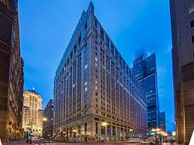
Conclusion
JW Marriot Chicago hotel can be viewed as the most similar hotel to the New York Marriott Downtown, based on combined evaluation of customer reviews and the types of venues located around the hotel.
Further considerations
Our preliminary analysis could be enhanced by using non public data or better access to Foursquare API:
Customer review data of locations around the hotel
Data about guests of the hotel (e.g., age, visiting duration, prices of rented rooms etc.)

